Slide 1




Perceived-Entity Linking for Improved Emotion Detection
Mark Adamik
Research Visit Plan
08-09-2025

Slide 2
Outline
Recap on my PhD topic
Overall idea
Plan for the visit

Slide 3
My PhD Topic

Slide 4
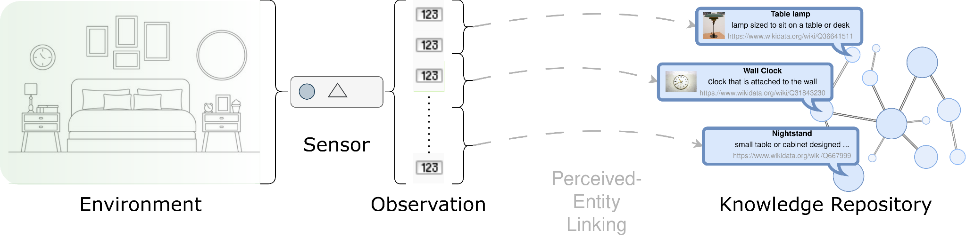
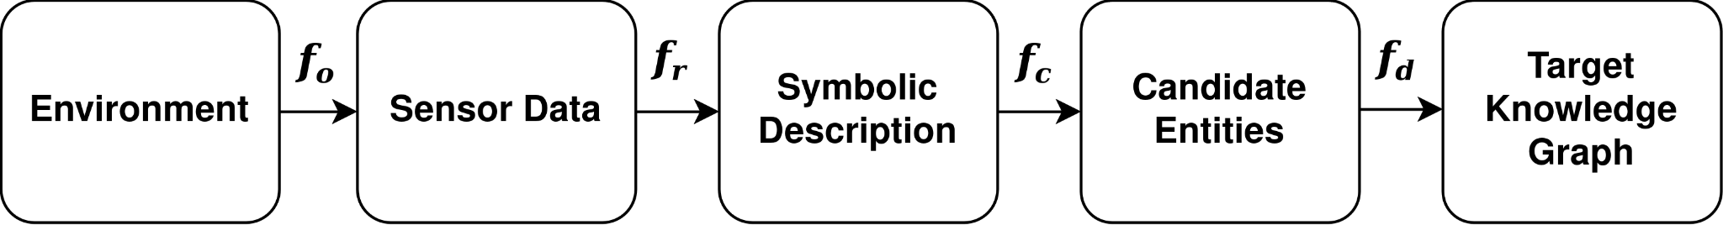
How to link sensory data to knowledge repositories?

Slide 5
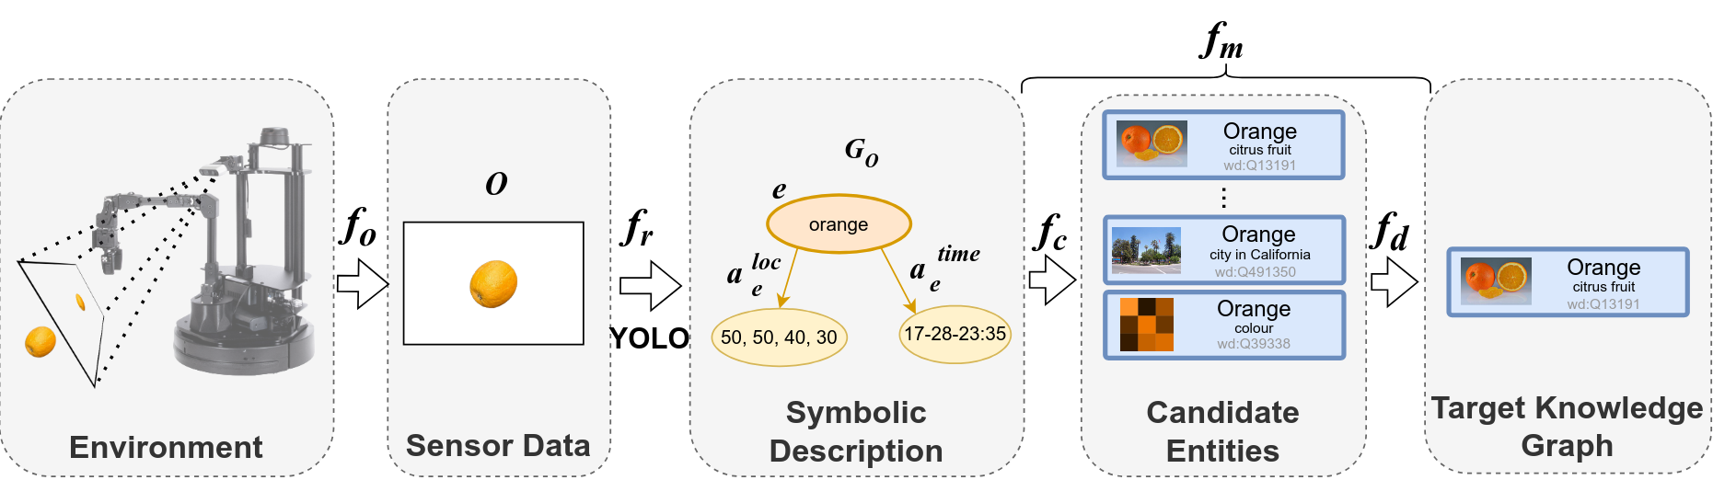
PEL Pipeline with EL

Slide 6
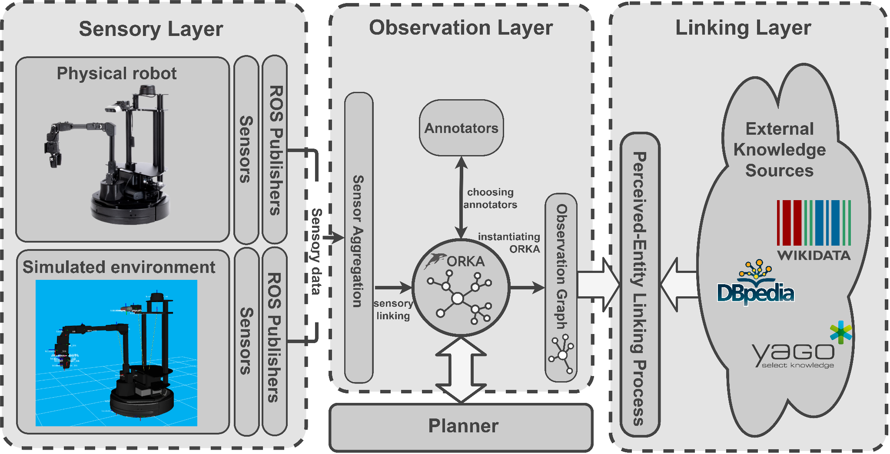
Perceived-Entity Linking System
Adamik et al.: Large-Scale Knowledge Graph as a Tool for Enhanced Robotic Perception, AAAI Fall Symposium, Unified Representations for Robotic Application Development (AAAI FSS - UR-RAD), 2024
Notes:
and once we had ORKA, we could move on to create a modular system where the PEL could be used.
We basically want to abstract away from the sensory layer, and with the use of ORKA, select different annotators to construct the observation graph, and then use the graph to perform the linking process
We presented this work last week at AAAI FSS

Slide 7
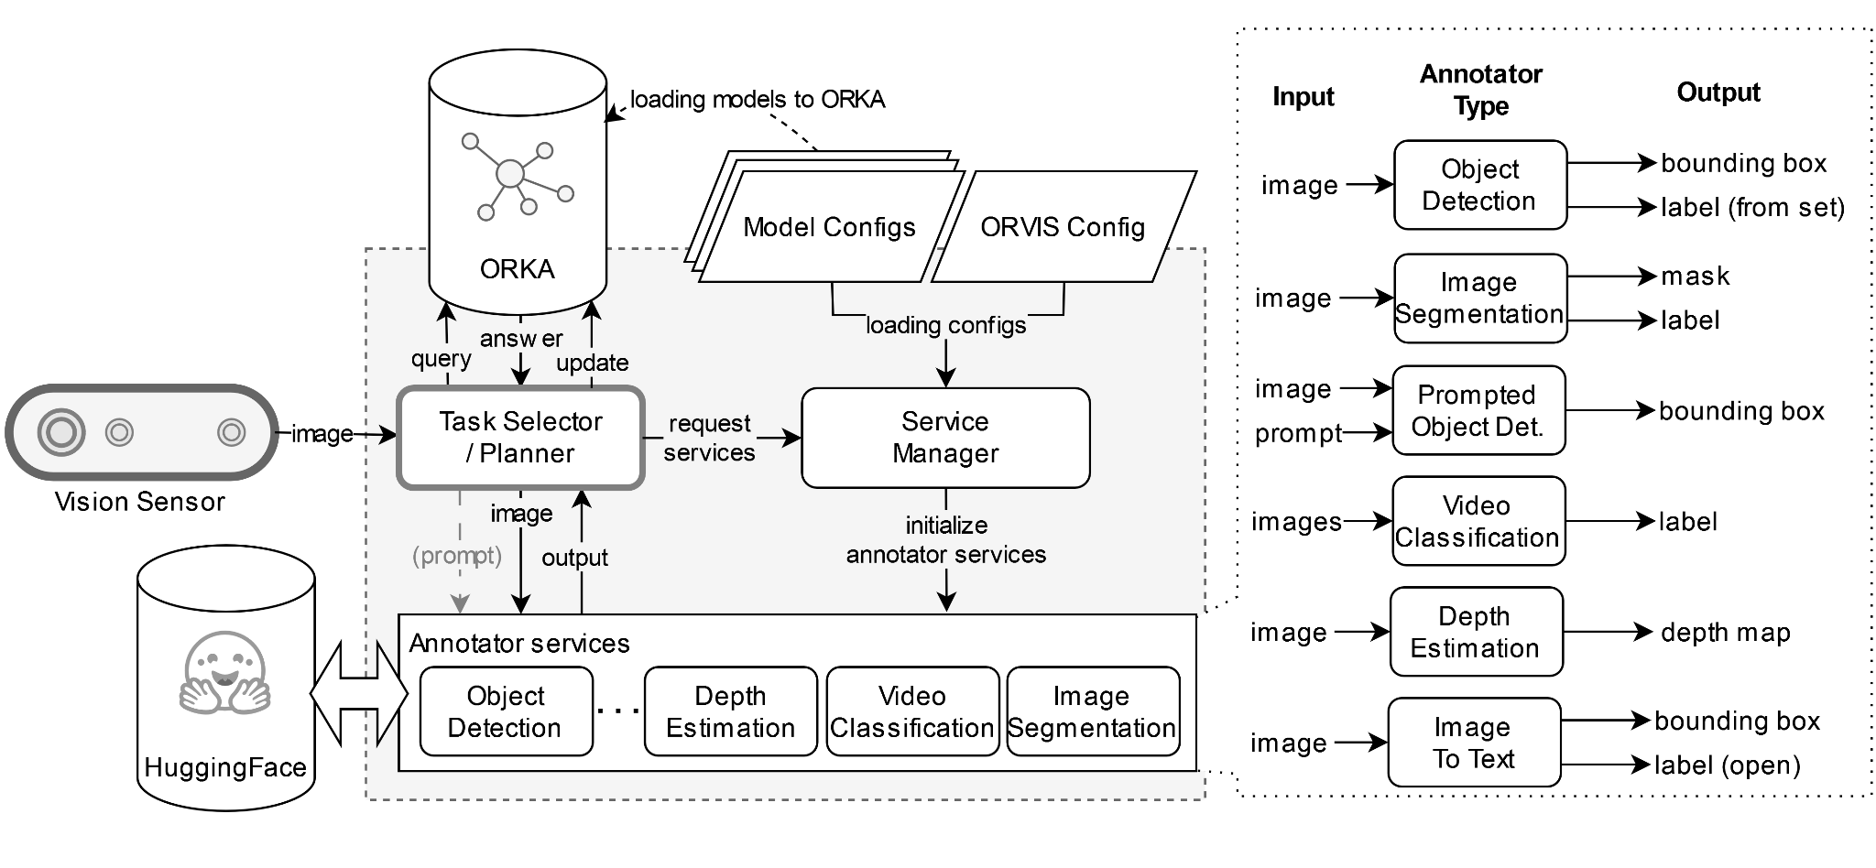
Ontology-Based Robot Vision System (ORVIS) - WIP
Notes:
The focus of this system is to leverage the model base that is hosted on huggingface, and to provide a framework that allows roboticists to reuse the models developed.

Slide 8
Main Idea

Slide 9
Research Problem
How can background knowledge be integrated into affective computing algorithms to improve their performance?

Slide 10
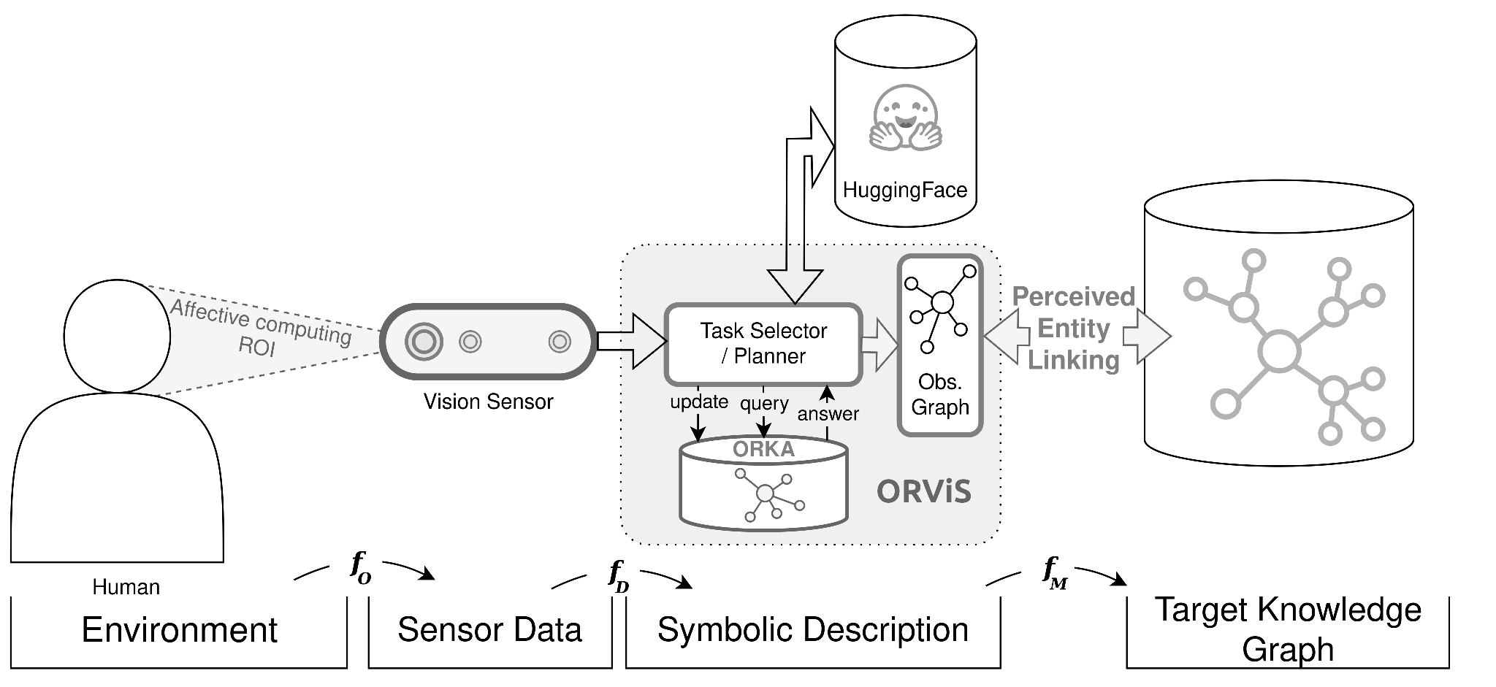
Initial System

Slide 11
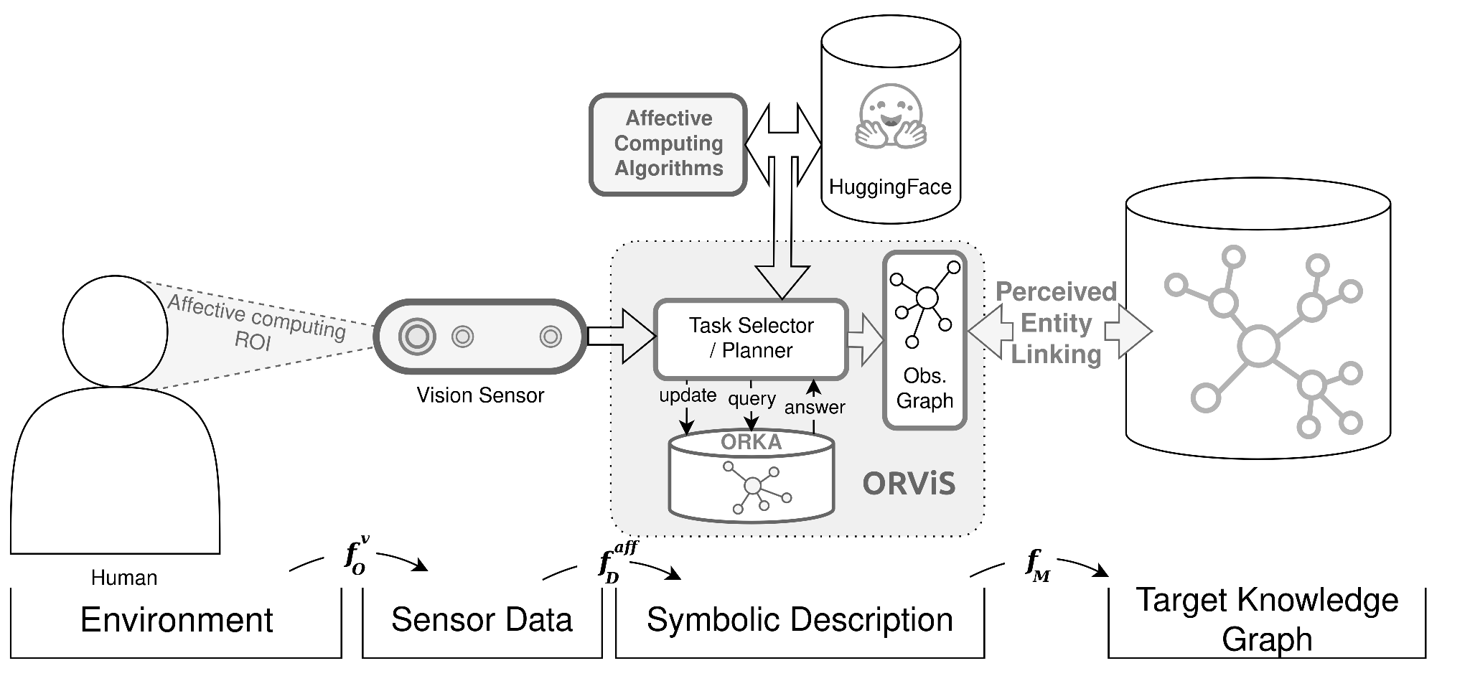
Initial System + Affective Computing

Slide 12
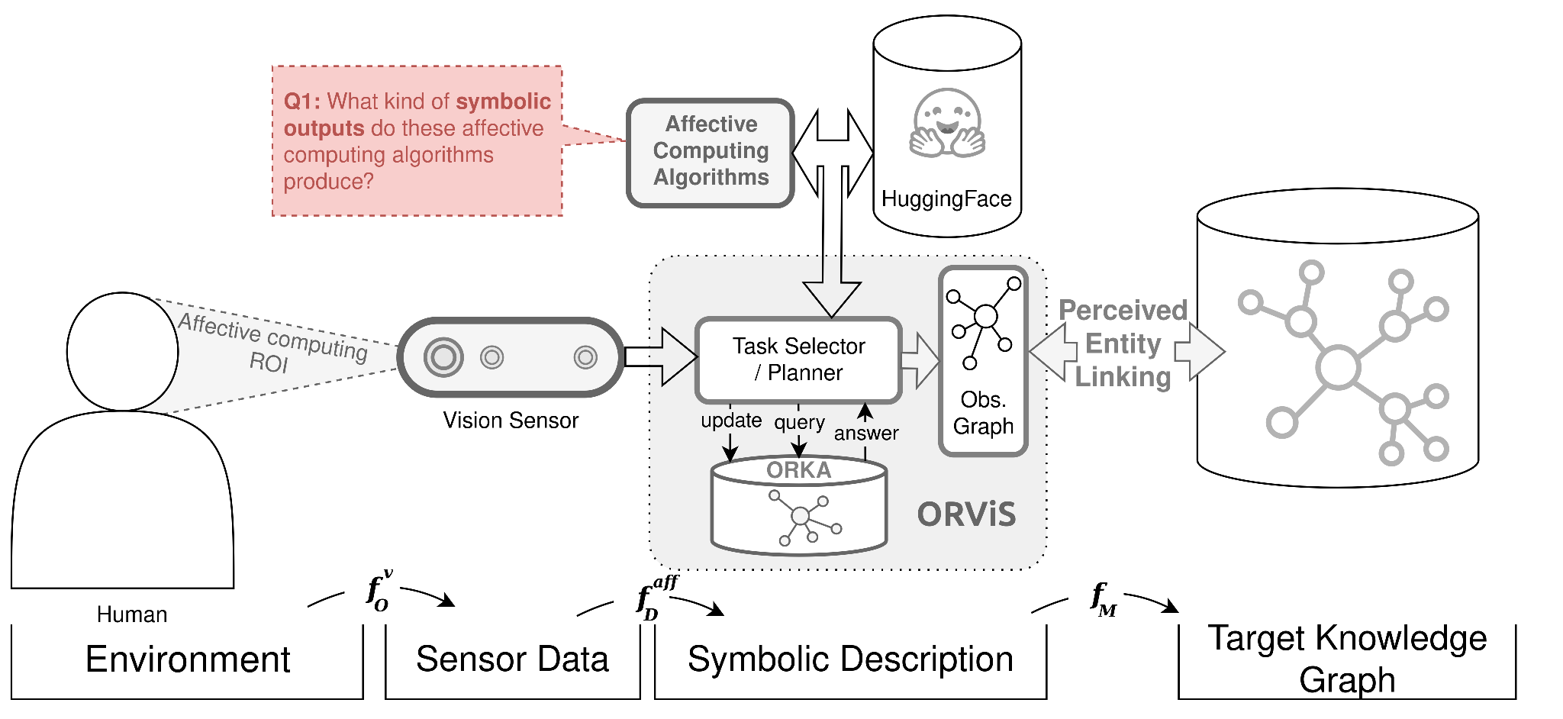
Q1: Symbolic output of affective computing alg.

Slide 13
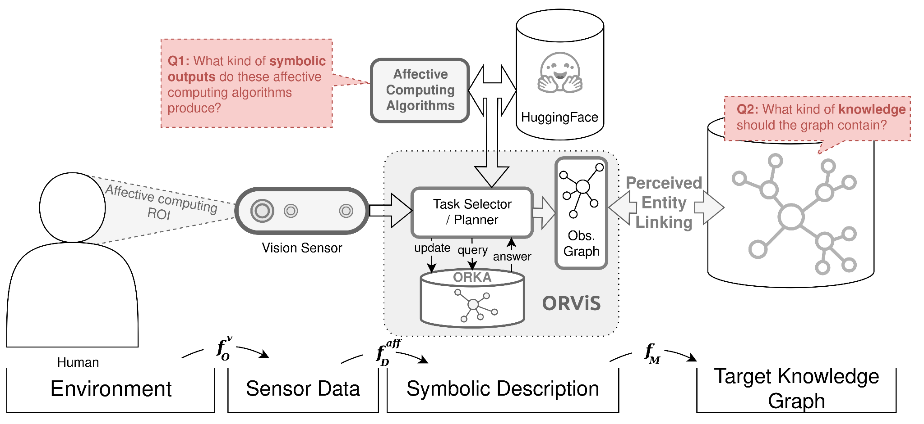
Q2: Contents of background knowledge

Slide 14
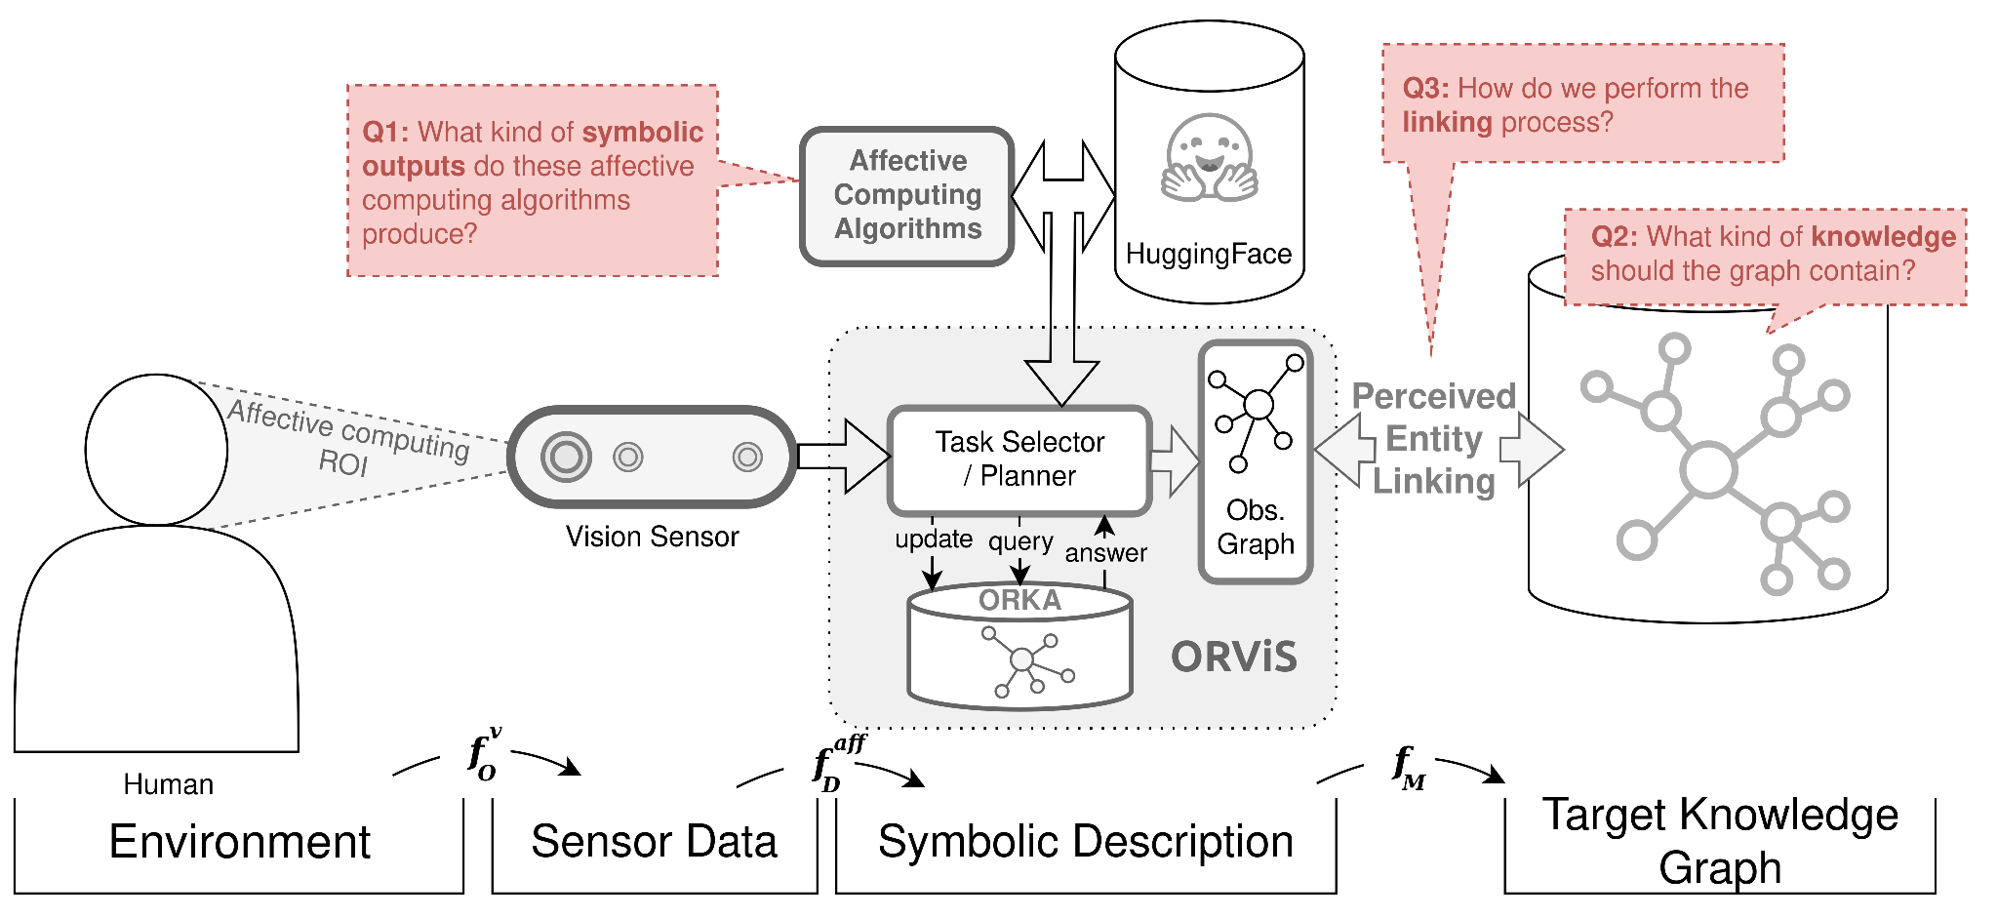
Q3: Performing PEL

Slide 15
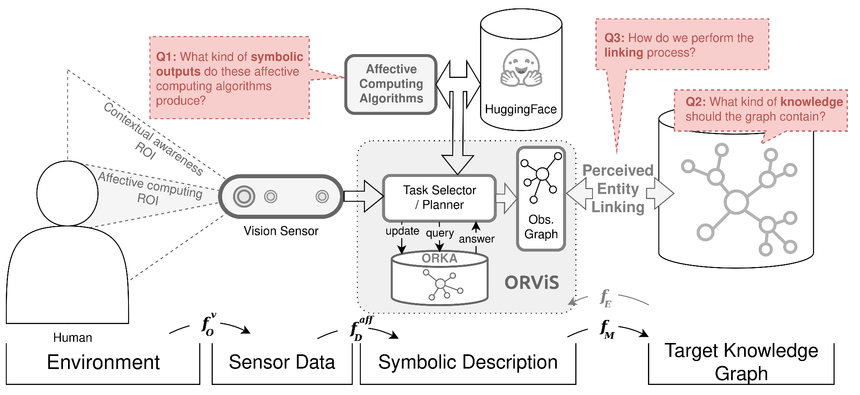
Incorporating context

Slide 16
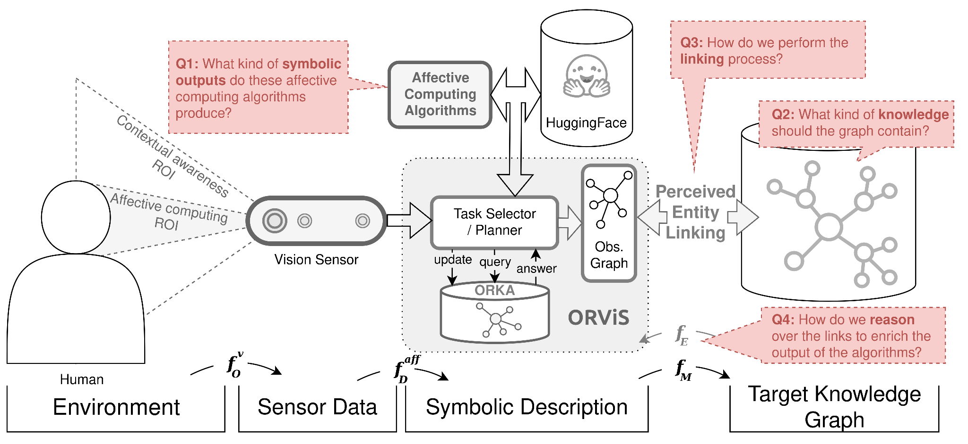
Q4: How to enhance output?

Slide 17
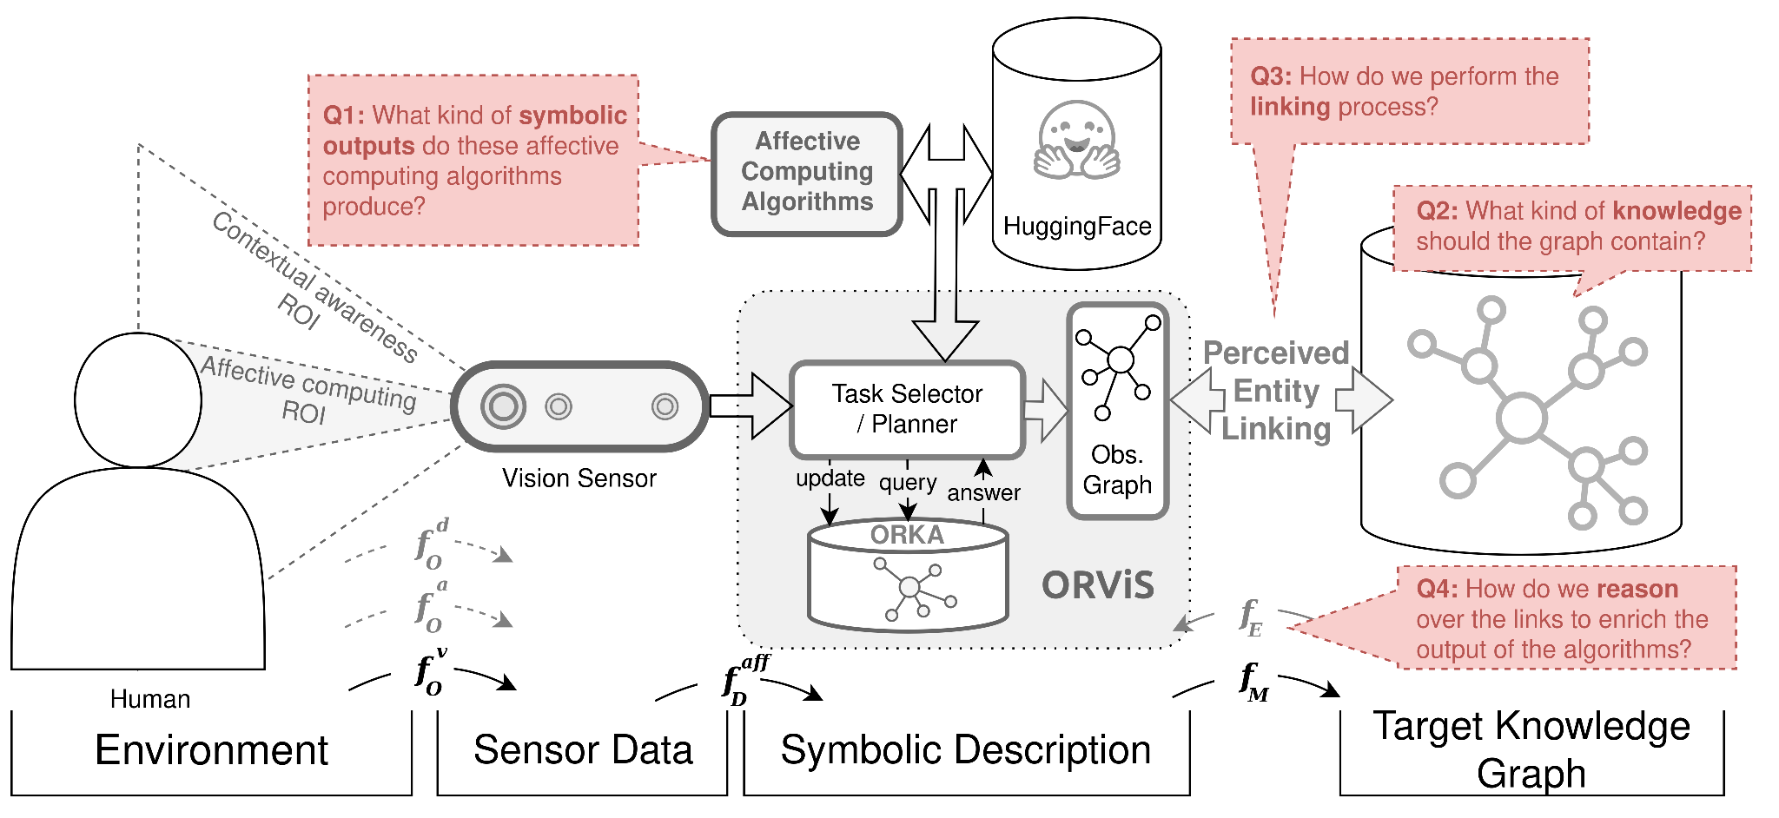
Additional modalities (future work?)

Slide 18
Approaches for the questions
Q1 : What kind of symbolic outputs do the affective computing algorithms produce?
A1: Investigate HF platform and existing CMVS approaches -> integrate into ORKA
Q2 : What kind of knowledge should the graph contain?
A2: Semi-manual knowledge engineering approach (Extending ORKA + Knowledge distillation + Investigate literature)
Q3 : How do we perform the linking process
A3: Compare RAG / Graph RAG / VLM - based approached against the baseline algorithm [1]
Q4 : How do we reason over the links to enrich the output of the algorithms
A4: Ablation study to compare system performance against raw output of the algorithms

Slide 19
(Initial) Timeline

Slide 20
Original Working Plan Draft
September – Orientation / Setup
○ Meet CMVS team, discuss possible collaboration points
○ Access datasets, tools, infrastructure
○ Literature review (affective computing + robotic perception)
○ Align ORKA + ORVIS with affective computing methods used by CMVS
○ Define concrete use cases / pilot scenarios
○ Start extending the ontology with affective concepts
October – Method Development / Integration
○ Integrate affective outputs (emotion, facial cues) into perception pipeline (Possibly PEL with VLMs)
○ Continue extending the ontology with affective concepts
○ Prototype small experiments / case studies
○ Hopefully weekly syncs with collaborators, refine approach
○ Mid-month (Workshop on the 9th of October): share intermediate results with team
November – Evaluation / Wrap-up
○ Evaluate methods in hybrid scenarios & Analyze results, document framework
○ Write report / draft paper on outcomes
○ Final presentation to CMVS team
Notes:
The focus of this system is to leverage the model base that is hosted on huggingface, and to provide a framework that allows roboticists to reuse the models developed.

Slide 21
Working Plan Draft Adjusted to Main Idea
September – Orientation / Setup
○ Meet CMVS team, discuss possible collaboration points
○ Access datasets, tools, infrastructure
○ Literature review (affective computing + robotic perception)
○ Align ORKA + ORVIS with affective computing methods used by CMVS
○ Define concrete use cases / pilot scenarios
○ Start extending the ontology with affective concepts
October – Method Development / Integration
○ Integrate affective outputs (emotion, facial cues) into perception pipeline (Possibly PEL with VLMs)
○ Continue extending the ontology with affective concepts
○ Prototype small experiments / case studies
○ Hopefully weekly syncs with collaborators, refine approach
○ Mid-month (Workshop on the 9th of October): share intermediate results with team
November – Evaluation / Wrap-up
○ Evaluate methods in hybrid scenarios & Analyze results, document framework
○ Write report / draft paper on outcomes
○ Final presentation to CMVS team
Notes:
The focus of this system is to leverage the model base that is hosted on huggingface, and to provide a framework that allows roboticists to reuse the models developed.

Slide 22
September
Monday
Tuesday
Wednesday
Thursday
Friday
Saturday
Sunday
Meet CMVS team
Arrange logistics and settle in
Draft a plan and brainstorm on use case
Literature review
Week 1
Monday
Tuesday
Wednesday
Thursday
Friday
Saturday
Sunday
Literature review
Get access to tools + datasets
Align my tools (ORKA/ORVIS/PEL) with tools
Define concrete use-case
Week 2
OULU HI Presentation
Monday
Tuesday
Wednesday
Thursday
Friday
Saturday
Sunday
Literature review
Get access to tools + datasets
Align my tools (ORKA/ORVIS/PEL) with tools
Define concrete use-case
Week 3
Monday
Tuesday
Wednesday
Thursday
Friday
Saturday
Sunday
Literature review
Get access to tools + datasets
Align my tools (ORKA/ORVIS/PEL) with tools
Define concrete use-case
Week 4
Monday
Tuesday
Wednesday
Thursday
Friday
Saturday
Sunday
Literature review
Get access to tools + datasets
Align my tools (ORKA/ORVIS/PEL) with tools
Define concrete use-case
Week 5
Notes:
The focus of this system is to leverage the model base that is hosted on huggingface, and to provide a framework that allows roboticists to reuse the models developed.

Slide 23
October
Monday
Tuesday
Wednesday
Thursday
Friday
Saturday
Sunday
Meet CMVS team
Arrange logistics and settle in
Draft a plan and brainstorm on use case
Literature review
Week 5
Monday
Tuesday
Wednesday
Thursday
Friday
Saturday
Sunday
Literature review
Get access to tools + datasets
Align my tools (ORKA/ORVIS/PEL) with tools
Define concrete use-case
Week 6
OULU HI Presentation
Monday
Tuesday
Wednesday
Thursday
Friday
Saturday
Sunday
Literature review
Get access to tools + datasets
Align my tools (ORKA/ORVIS/PEL) with tools
Define concrete use-case
Week 7
Monday
Tuesday
Wednesday
Thursday
Friday
Saturday
Sunday
Literature review
Get access to tools + datasets
Align my tools (ORKA/ORVIS/PEL) with tools
Define concrete use-case
Week 8
Monday
Tuesday
Wednesday
Thursday
Friday
Saturday
Sunday
Literature review
Get access to tools + datasets
Align my tools (ORKA/ORVIS/PEL) with tools
Define concrete use-case
Week 9
Notes:
The focus of this system is to leverage the model base that is hosted on huggingface, and to provide a framework that allows roboticists to reuse the models developed.

Slide 24
November
Monday
Tuesday
Wednesday
Thursday
Friday
Saturday
Sunday
Experiments (in case more needed)
Week 10
Monday
Tuesday
Wednesday
Thursday
Friday
Saturday
Sunday
Paper writing / Reporting
Week 11
Monday
Tuesday
Wednesday
Thursday
Friday
Saturday
Sunday
Finishing up the paper?
Week 12
Monday
Tuesday
Wednesday
Thursday
Friday
Saturday
Sunday
Final presentation?
Week 13
Notes:
The focus of this system is to leverage the model base that is hosted on huggingface, and to provide a framework that allows roboticists to reuse the models developed.

